Slide 1
Debugging

Slide 2
Introduction:
Debugging is a process of finding and reducing the number of bugs, or defects. Debugging occurs as a consequence of successful testing.
That is, when a test case uncovers an error, debugging is the process that results in the removal of the error.

Slide 3
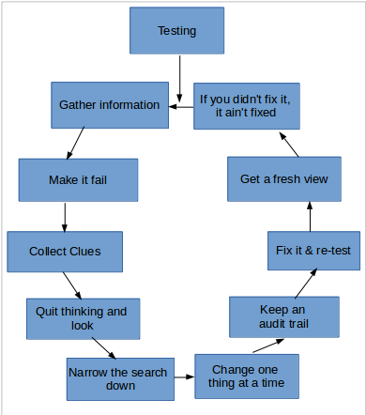
Steps of Debugging
1. Gather information 8. Fix it & re-test
2 Make it fail 9 Get a fresh view
3 Collect Clues 10 If you didn't fix it, it ain't fixed
4. Quit thinking and look
5. Narrow the search down
6. Change one thing at a time
7. Keep an audit trail

Slide 4
1.Gather Information
Know the fundamentals of the system.
Understand the frameworks involved.
Read the APIs and communication interfaces.
Understand what each module of the system does.

Slide 5
2. Make it Fail
Start at the beginning.
Automate the failure.
No detail is insignificant.
Intermittent failures?
Isolate the failure.

Slide 6
3. Collect Clues
Collect clues as to bug
Clues suggest where problem might be
ex:using type of error,etc.

Slide 7
4. Quit Thinking and Look
Gather the low level details and "see" the failure.
Understand the context of the bug.
Be methodical.
Make no assumptions.

Slide 8
5. Narrow the Search
Start at the bad end (e.g. the error log) and work your way up the chain looking at the various.
Fix the bugs you know about - fixing one could fix the other

Slide 9
6. Change one thing at a time
Compare with a good one !
Use a rifle not a shotgun.
What’s changed recently, it used to work!

Slide 10
7. Keep an Audit Trail
Keep a day book of what you did.
During debugging write down...
1.What you did… 2.In what order… 3.And what happened!
Be specific and consistent.

Slide 11
8.Fix it & Re-test
Attempt to replicate again
• No temporary workarounds!
• May introduce other issues.
• Never get replaced with true solutions.

Slide 12
9. Get a Fresh View
Get another viewpoint on the solution.
Talk to somebody about the problem.
Ask an expert:
● Email the author
● Check the forums
● Subscribe to the mailing list

Slide 13
10. If you didn’t Fix it, it ain’t fixed
The most important lesson by far...
●Fix the root cause
●Make sure it can’t possibly happen again
●Fix the process at fault

Slide 14
Common types of debugging:
Brute force
Print/Trace Debugging
Backtracking Method
Divide & Conquer

Slide 15
Brute Force
Most common and least efficient for isolating the cause of a software error.
• a printout of all registers and relevant memory locations is obtained and studied. All dumps should be well documented and retained for possible use on subsequent.

Slide 16
2. Print/Trace Debugging
Watching the flow of execution after adding print statements to the original code.
Post Mortem Debugging - analysis of a memory dump from a program that has crashed.

Slide 17
3. Backtracking method
• The process starts from the site where a particular symptom gets detected, from there on backward tracing is done across the entire source code till we are able to lay our hands on the site being the cause.
• Unfortunately, as the number of source lines increases, the number of potential backward paths may become unmanageably large.

Slide 18
4. Divide & Conquer
Identify different code sections Set breakpoints at the boundaries Isolate issue to one particular area.
Focus efforts on that area introduces the concept of binary partitioning.

Slide 19
4. Divide & Conquer
Identify different code sections Set breakpoints at the boundaries Isolate issue to one particular area.
Focus efforts on that area introduces the concept of binary partitioning.

Slide 20
Debugging Tools

Slide 21
Advantages of using Debugging Tools
As debugging is the hardest and most time consuming part of programming, any improvement in that process can make as big difference as between minutes and weeks.
Possible to interactively debug executing program (or its trace) - to setup a breakpoint and preview current value of variables, etc.

Slide 22
GDB

Slide 23
Introduction
GDB may not be intuitive but it is very powerful
Easy to use, just not so easy to learn (TUI: Text User Interface)
As useful as it is poorly named!

Slide 24
Features
GDB offers extensive facilities for tracing and altering the execution of computer programs.
The user can monitor and modify the values of programs' internal variables, and even call functions independently of the program's normal behavior.

Slide 25
Execution Instructions:
g++ -g program.cpp (for c : gcc -g program.c)
gdb ./a.out

Slide 26
Commands
r-run c-continue
f - Runs until the current function is finished
s - Runs the next line of the program
s N - Runs the next N lines of the program
n - Like s, but it does not step into functions
u N - Runs until you get N lines in front of the current line

Slide 27
Commands Cont.
p var - Prints the current value of the variable "var"
bt - Prints a stack trace
u - Goes up a level in the stack
d - Goes down a level in the stack
q - Quits gdb
*(Other commands in research files)

Slide 28
Types of errors
seg fault - detected divide by 0 - detected
memory leak - undetected access unallocated memory - detected
access unallocated memory (static) - detected
access uninitialized memory - undetected
overflow - undetected

Slide 29
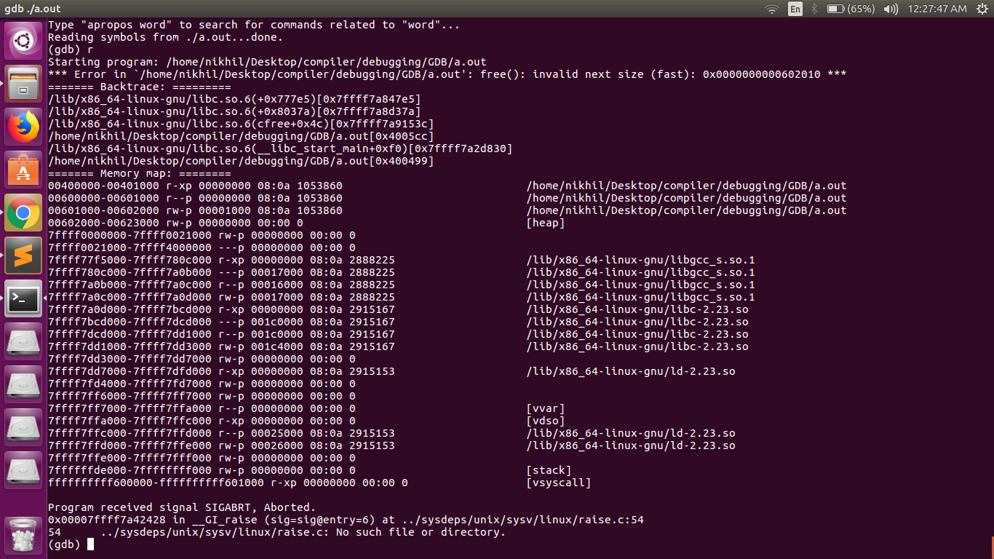
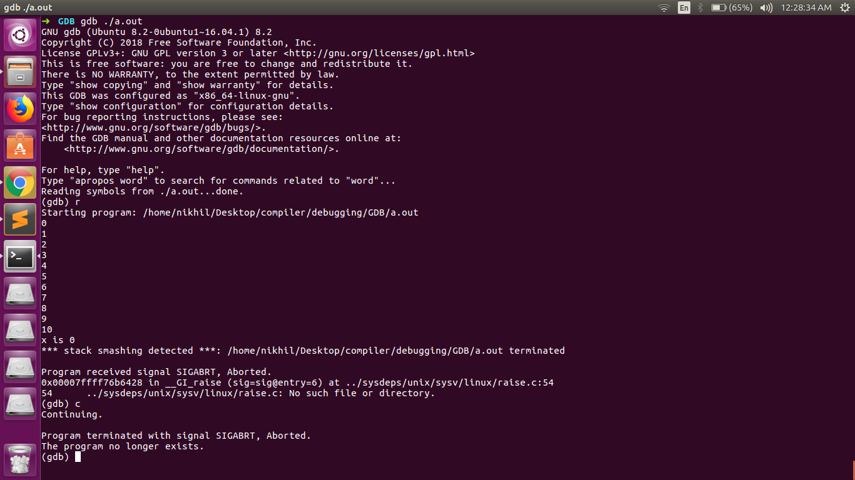
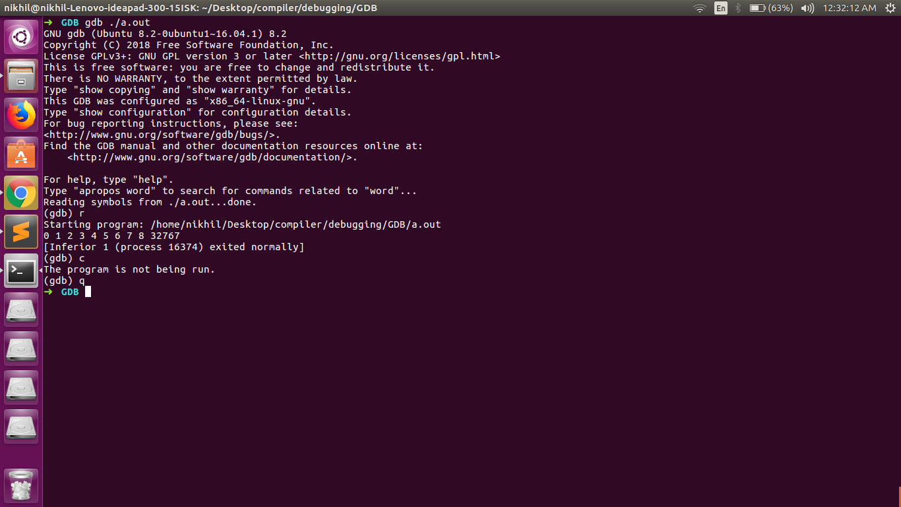
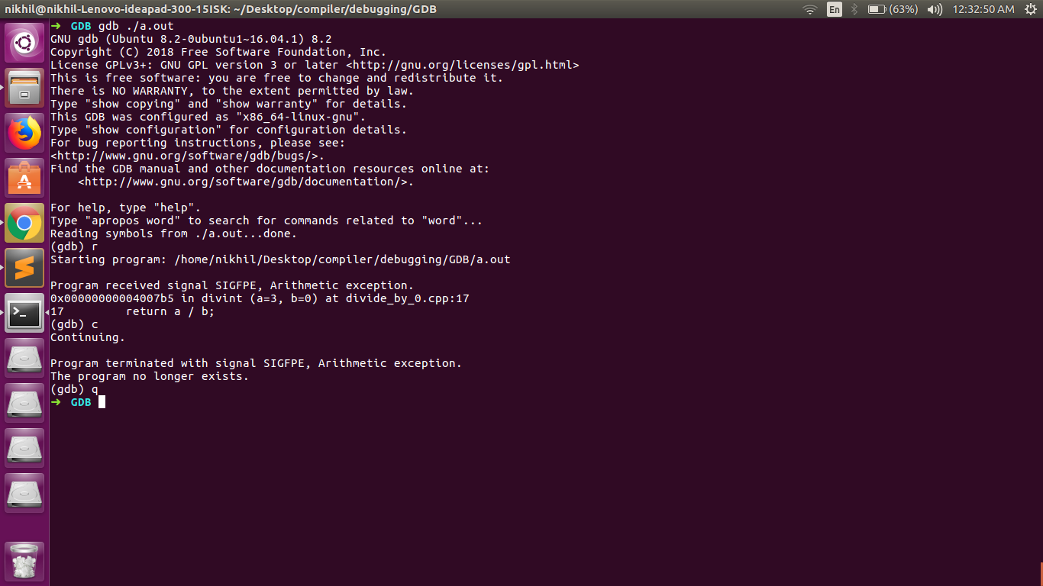
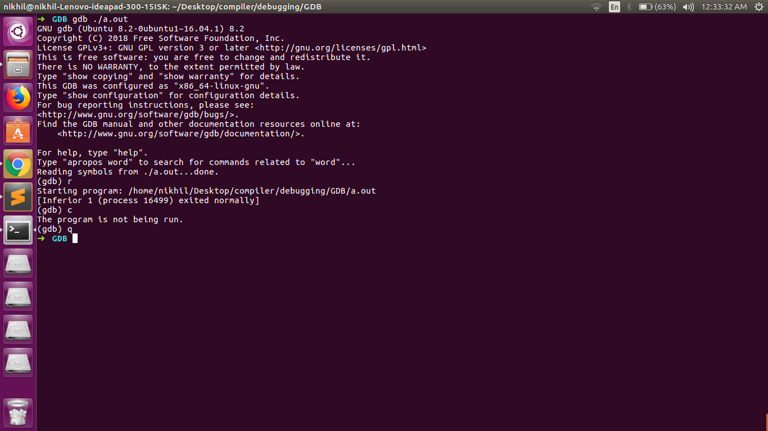
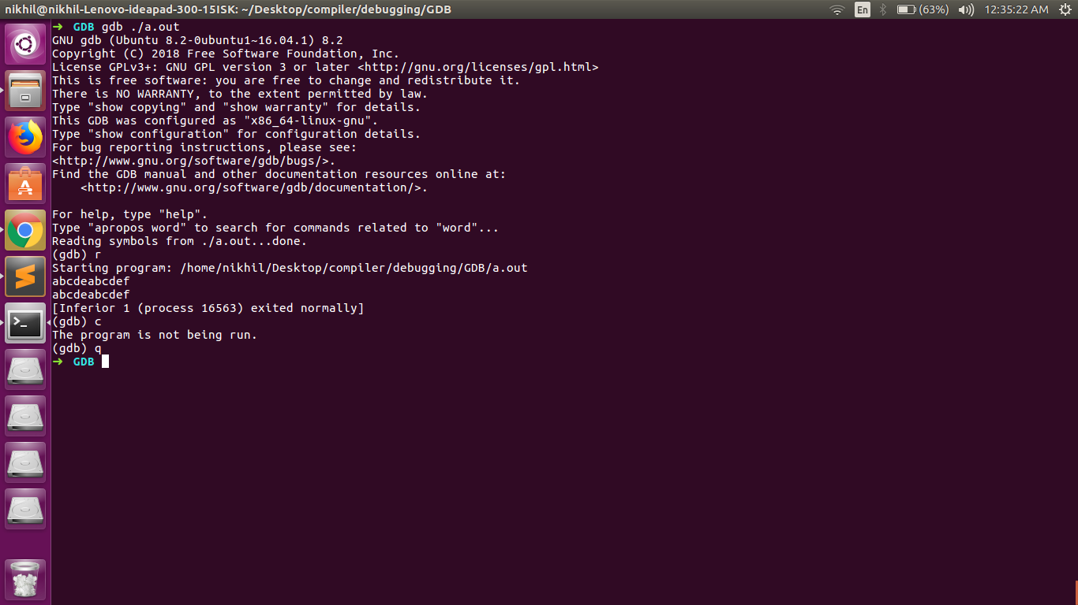
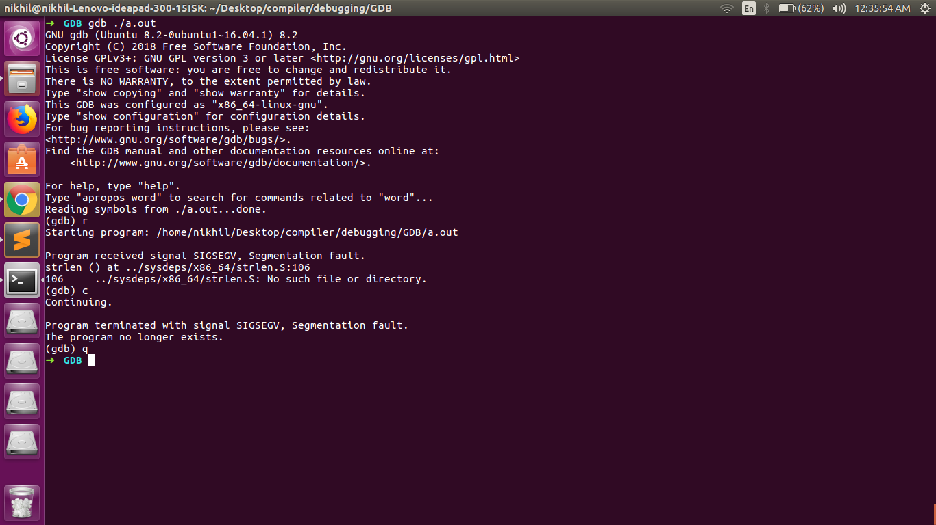
*(code and output screenshots are given in research folder)

Slide 30
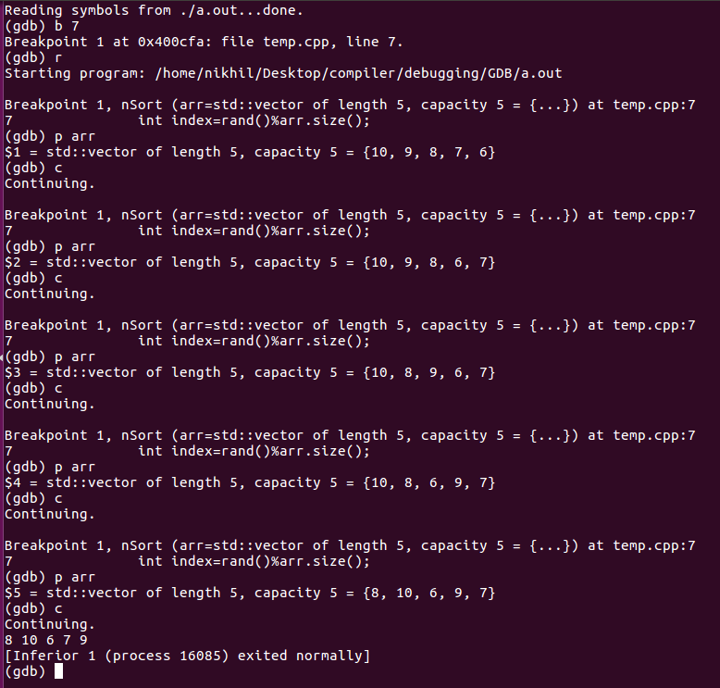
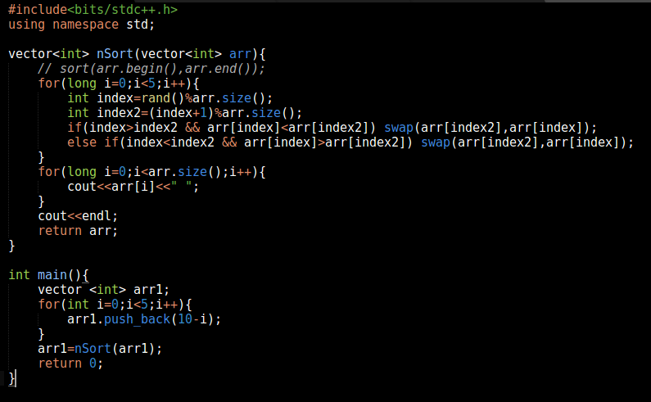
Example 1(Sorting)

Slide 31
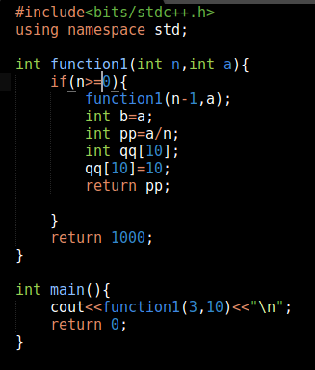
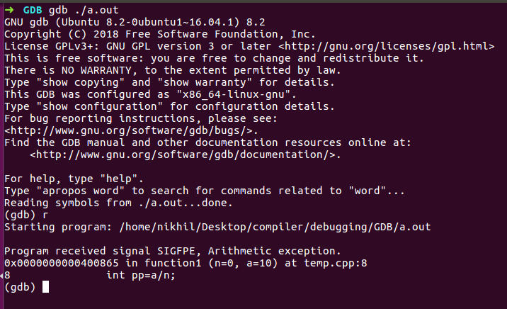
Example 2(Masking)

Slide 32
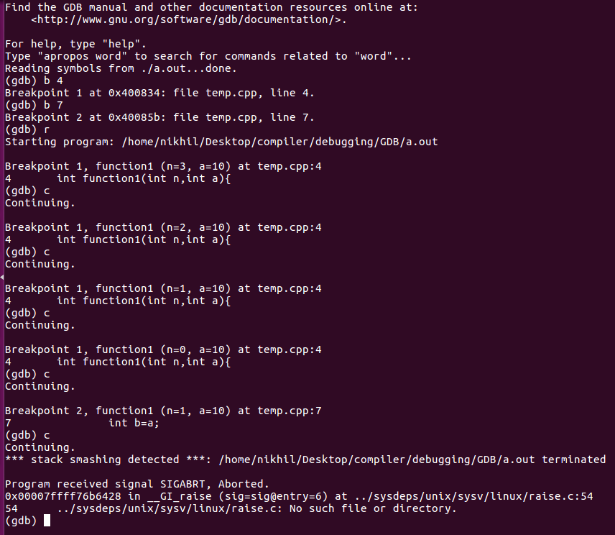
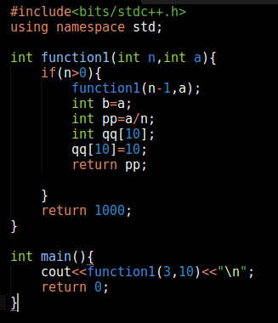
Example 2(Masking) Cont.

Slide 33
Valgrind

Slide 34
Introduction
Valgrind is a memory mismanagement detector. It shows you memory leaks, de-allocation errors, etc. Actually, Valgrind is a wrapper around a collection of tools that do many other things (e.g., cache profiling).

Slide 35
Features
Memcheck - memory leak detection
Cachegrind - collecting data about cache hits/mises
Callgrind - analysing function calls,
Massif - analyse memory comsuption
Helgrind - analyze synchronization errors

Slide 36
Execution Instructions
g++ -Wall -pedantic -g program.cpp
(for c : gcc -Wall -pedantic -g program.c)
valgrind ./a.out

Slide 37
Types of errors
seg fault - detected divide by 0 - detected
memory leak - detected access unallocated memory - detected
access unallocated memory (static) - detected
access uninitialized memory - detected
overflow - detected

Slide 38
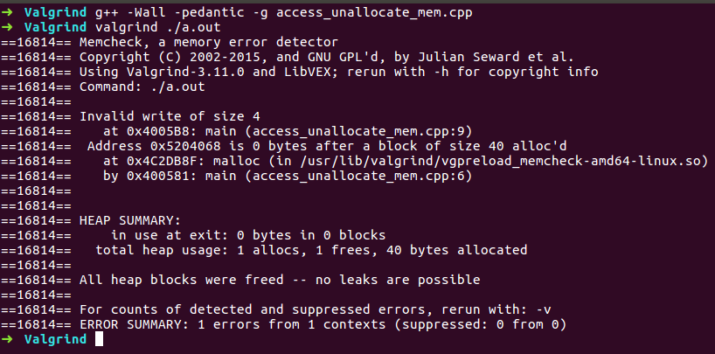
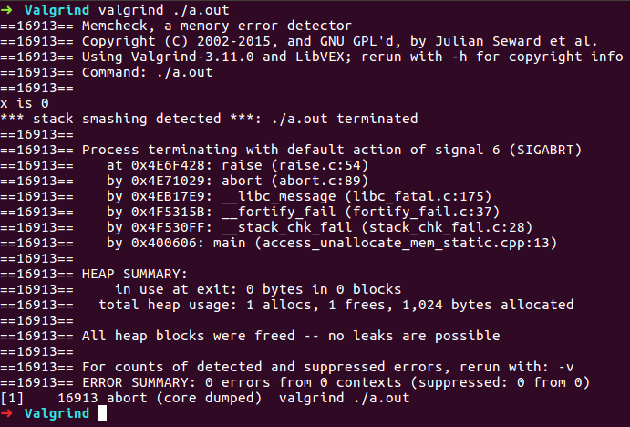
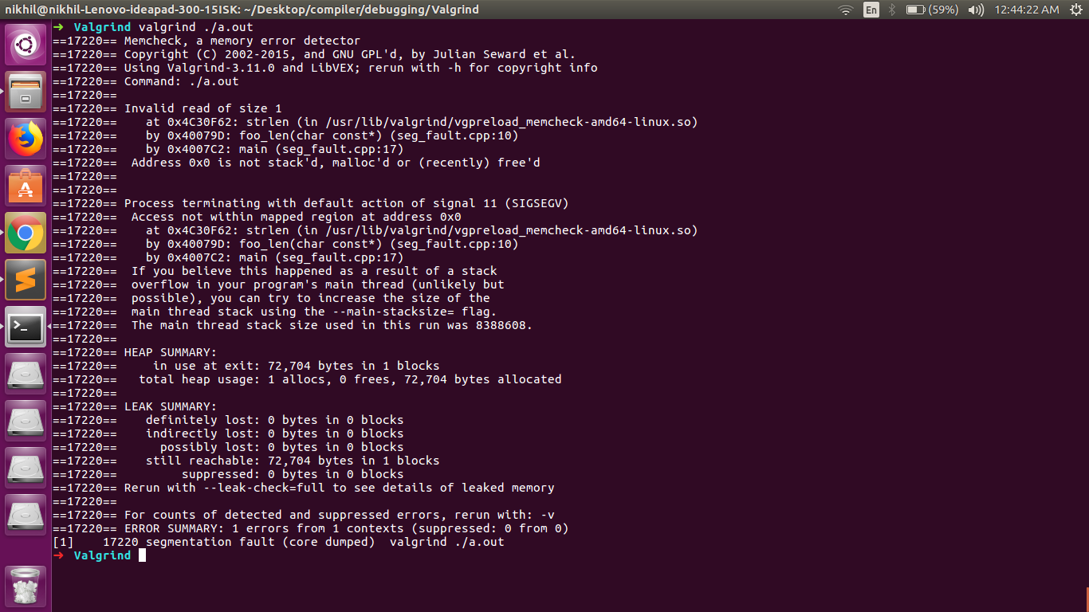
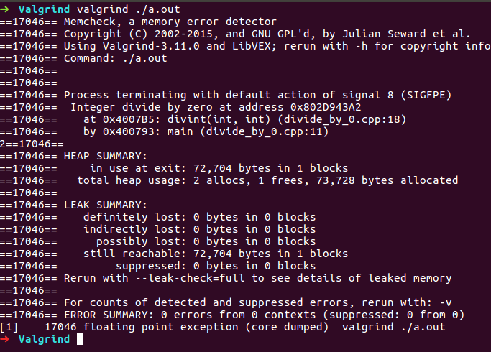
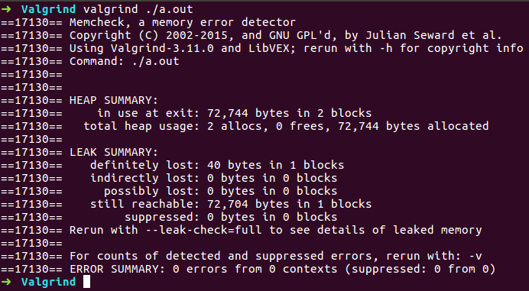
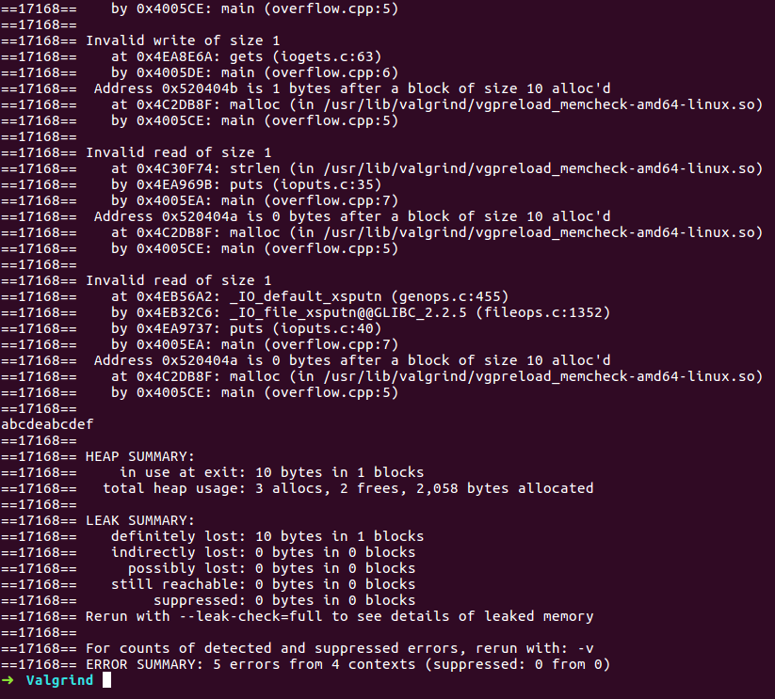
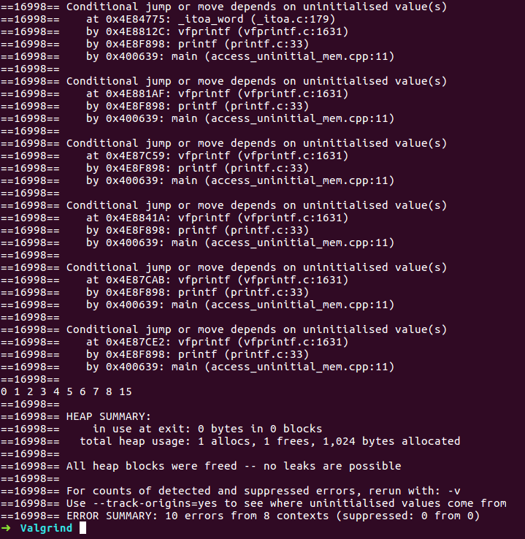
*(code and output screenshots are given in research folder)

Slide 39
Kdevelop

Slide 40
Introduction
KDevelop is a modern integrated development environment (IDE) for C++ (and other languages) that is one of many KDE applications.
It is a GUI

Slide 41
Features
Low Resource Cost.
Full Language Support
Context-Based Completion
GUI-Integrated VCS
Pop-Up Navigation
Easy Adaptation

Slide 42
Execution Instructions
Open Kdevelop application
Attach the code
Use debug option
Possible to insert breakpoints, etc. using the interface(gdb commands)

Slide 43
Types of errors
seg fault - detected divide by 0 - detected
memory leak - undetected access unallocated memory - detected
access unallocated memory (static) - detected
access uninitialized memory - undetected
overflow - undetected

Slide 44
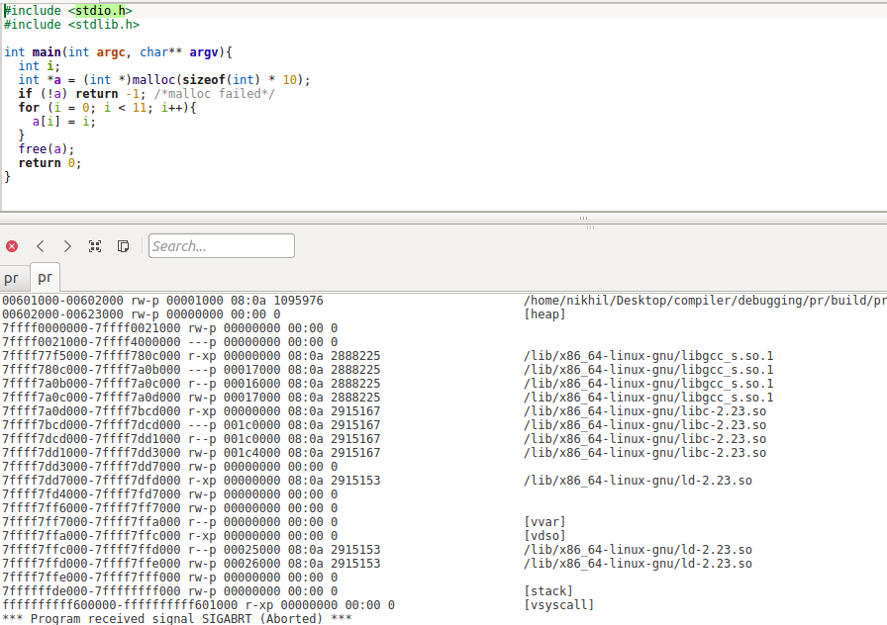
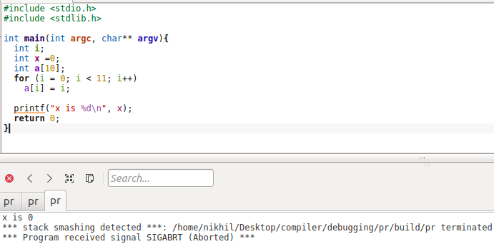
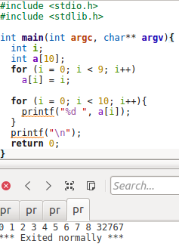
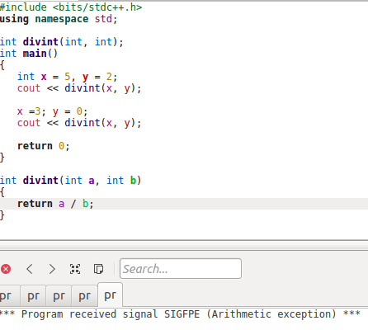
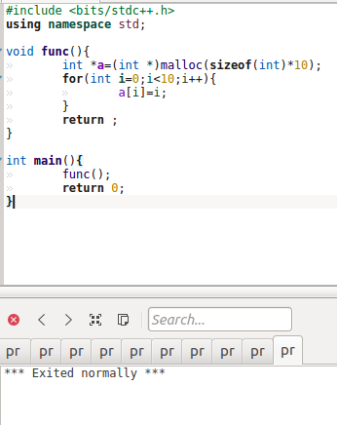
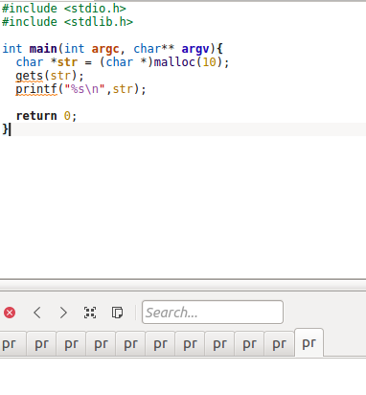
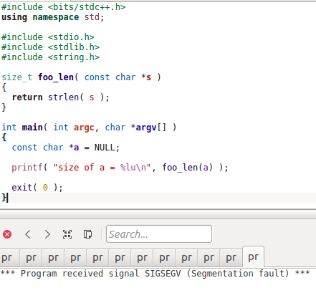
*(code and output screenshots are given in research folder)

Slide 45
Nemiver

Slide 46
Introduction
Nemiver is a project to write a standalone graphical debugger that integrates well in the GNOME desktop environment.
It currently features a backend which uses the well known GNU Debugger gdb

Slide 47
Features
In addition to the toolbar buttons, you can toggle breakpoints simply by clicking in the margin on the line you want to break on.
-Attaching to a running process is as simple as typing "nemiver --attach <the-name-of-your-program>". You are not obliged to know the PID of the process beforehand.

Slide 48
Execution Instructions
g++ -g program.cpp (for c : gcc -g program.c)
nemiver ./a.out

Slide 49
Types of errors
seg fault - detected divide by 0 - detected
memory leak - undetected access unallocated memory - detected
access unallocated memory (static) - detected
access uninitialized memory - undetected
overflow - undetected

Slide 50
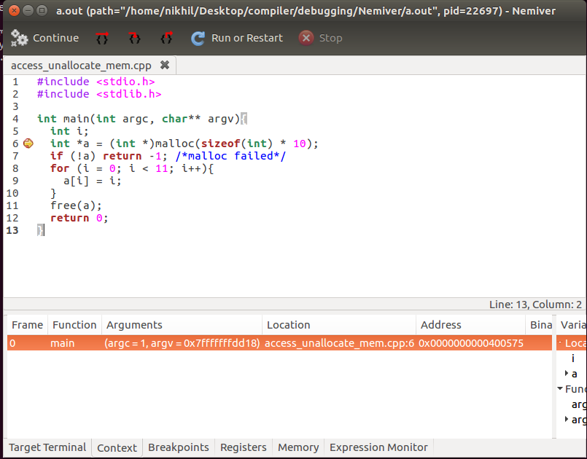
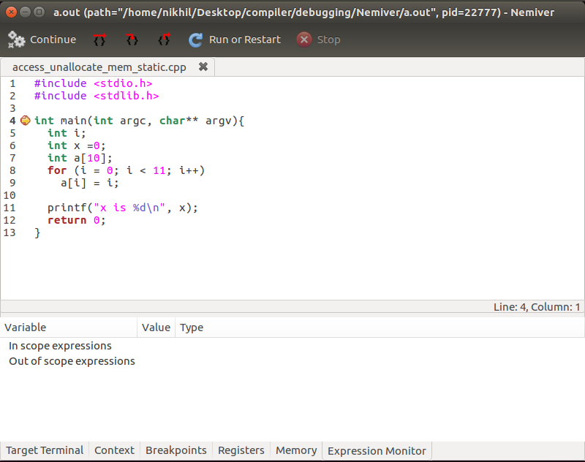
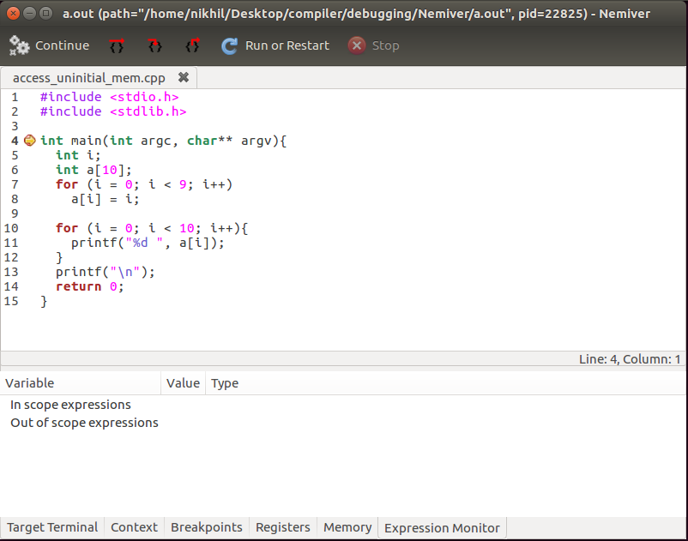
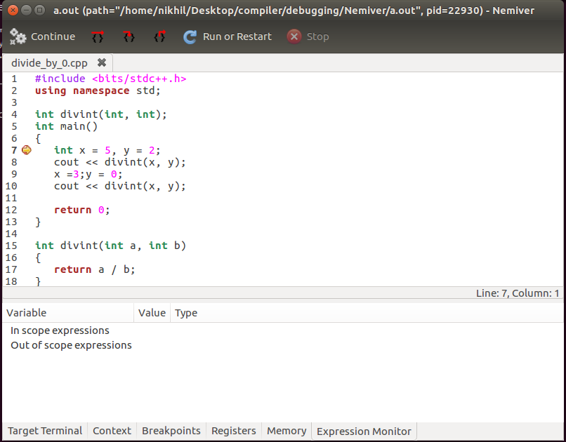
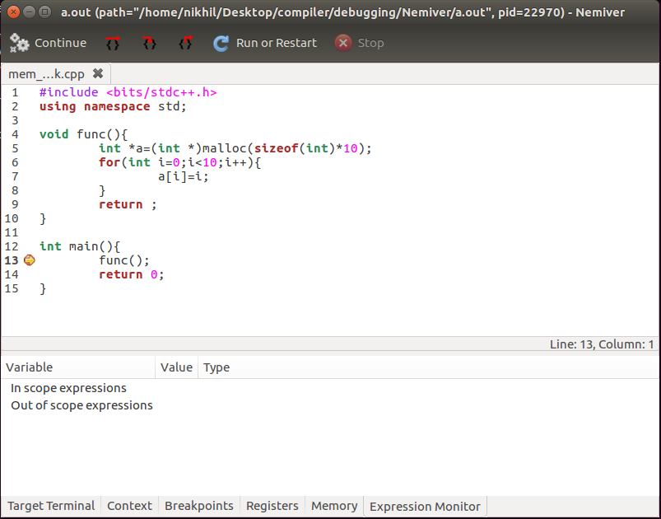
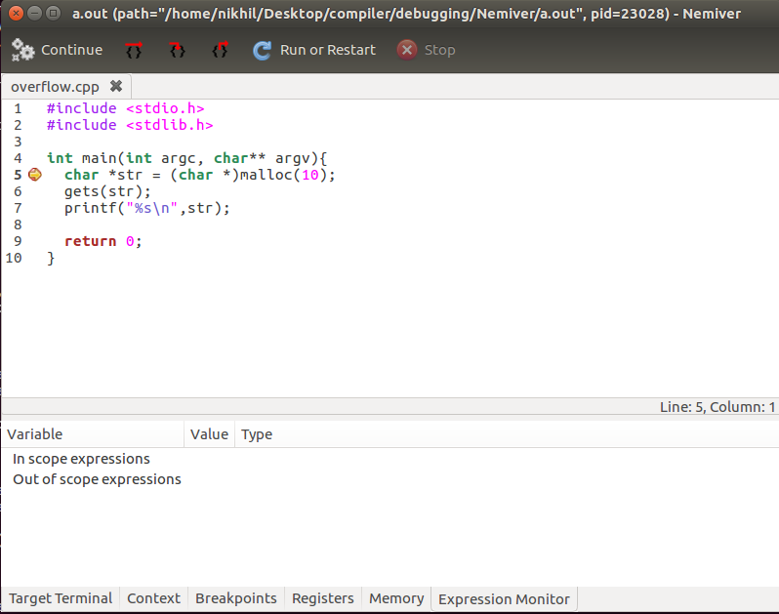
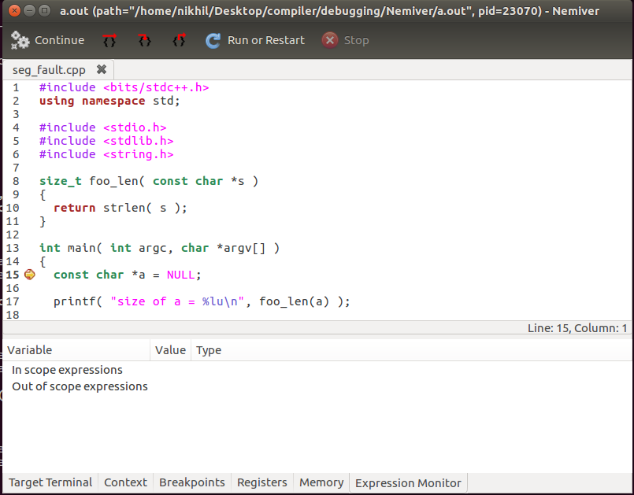
*(code and output screenshots are given in research folder)

Slide 51
Tips on Debugging
1. Computers aren’t random, and neither are bugs.
2. Persistence will always pay off.
3. Don’t be afraid to dive deep.
4. Don’t make assumptions or take things for granted.

Slide 52
Long-Term results
• Gain experience
• Learn how the system works
• Develop a “sixth sense”

Slide 53
Quotations
“The bug is not moving around in your code, trying to trick or evade you.
It is just sitting in one place, doing the wrong thing in the same way every time.”
“ If debugging is the process of removing software bugs, then programming must be the process of putting them in. ”
“First, solve the problem. Then, write the code.”
“Error messages are your best friend. : You will grow to love them for the useful information they give you.”

